Slide 1
Class Schedule
Module Management Made Easy

Slide 2



Previous Module Management Options
Excel
Word
Other TXT
Pros
Familiar interface
Automatic time calculation
Nice formatting
Cons
Limited Automation
Requires
Excel know-how
Time per schedule
Changed take time
Pros
Familiar interface
Nice formatting
Cons
No automation
Manual Modification
Requires
Word
Word know-how
Manually calculate time
Pros
Simple (Anyone can edit)
Small file (easy sharing)
Cons
No automation
No advanced formatting
Difficult to read
Requires
Any text editor
Manual time calculation

Slide 3


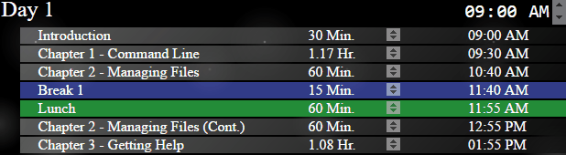
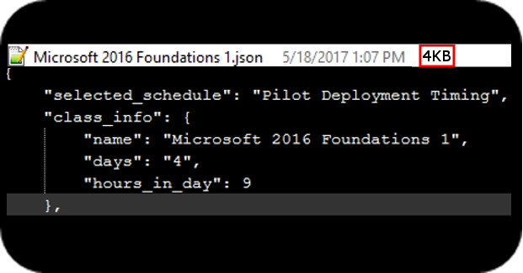
New Module Management Option!
ClassSchedule
Manage multiple classes and schedules from one tool and home-screen.
Schedules stored in small and sharable JSON format.
Easily manage module position, name, and time!
* Enter presentation mode to view animations and zoom into screenshots.

Slide 4
How-To

Slide 5
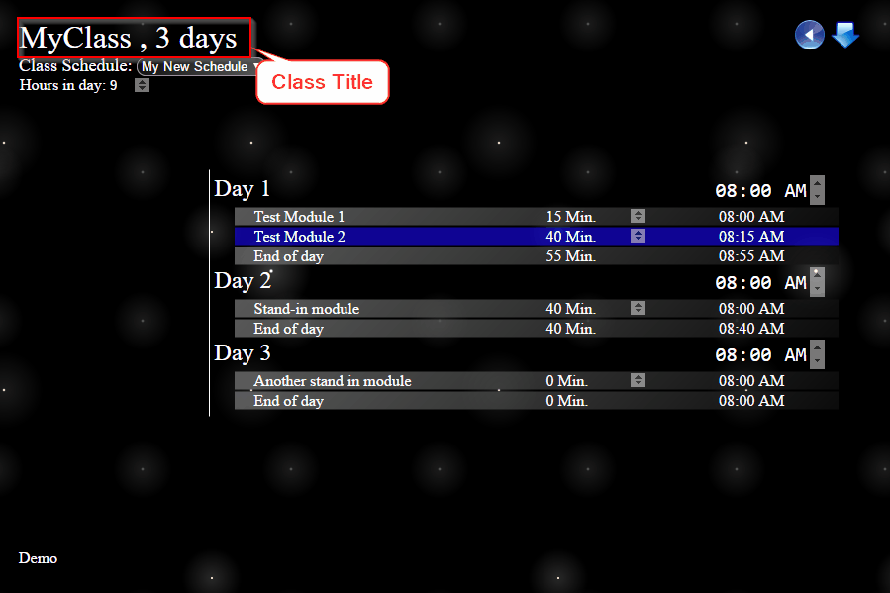
Class Components
* Enter presentation mode to view animations

Slide 6
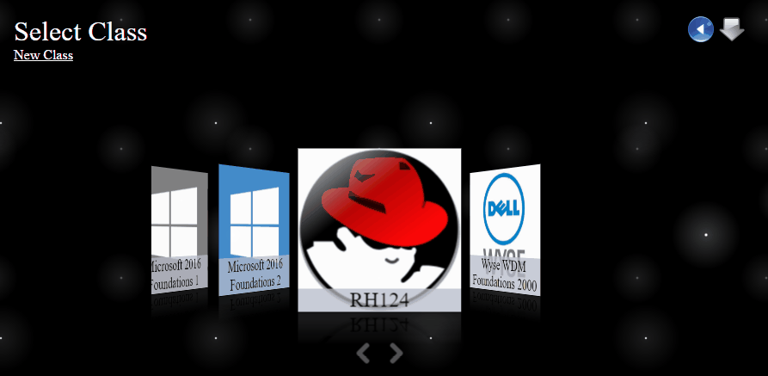
Create New Class
Click on “New Class”
Type new class name
Choose new class image
Type class type
  Generally will be ILT/VILT
Type number of days the class will be
Type name of initial schedule
* Enter presentation mode to view animations

Slide 7
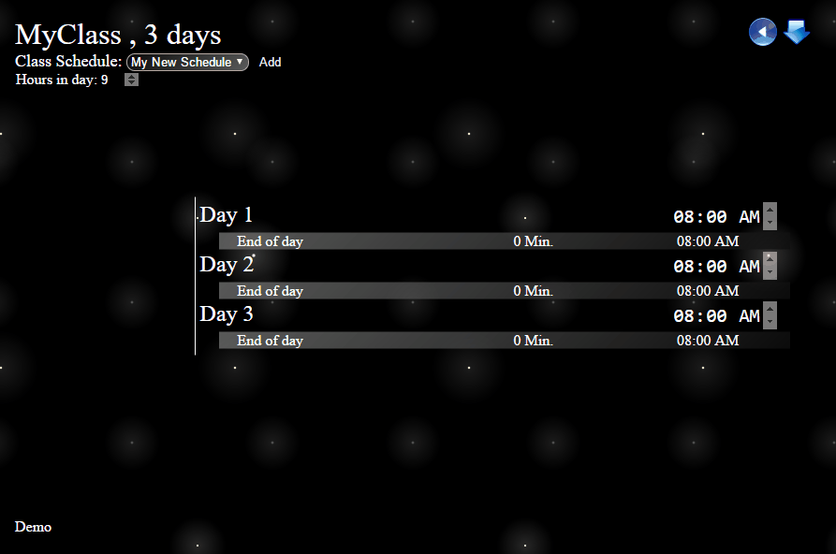
Add New Modules
Open Class
Right click on module or end of day row
Select insert above or insert below
Type module name
Press enter
* Enter presentation mode to view animations

Slide 8
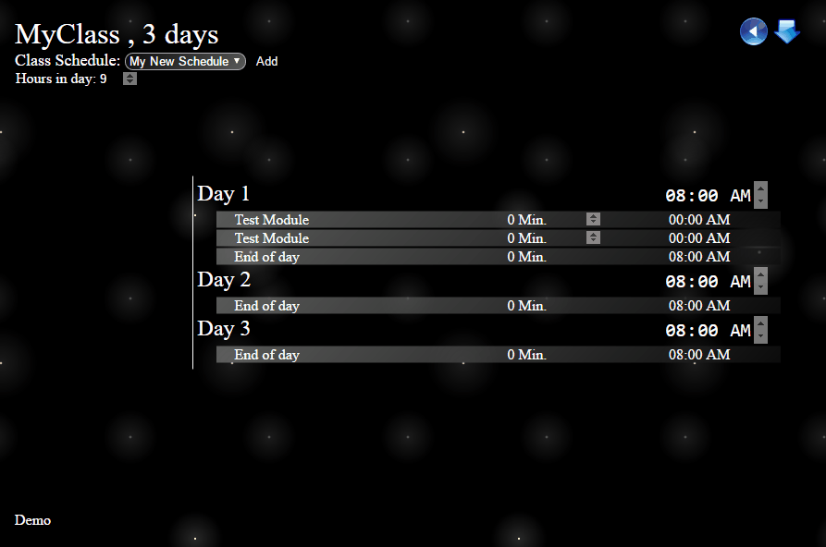
Change Module Name
Open Class
Right click on module
Select rename
Type new name
Press enter
* Enter presentation mode to view animations

Slide 9

Change Module Duration
Open Class
Right click module and choose “Set Time (Minutes)”
Type new duration in minutes
Press enter
OR Press up or down arrow beside duration
* Enter presentation mode to view animations

Slide 10
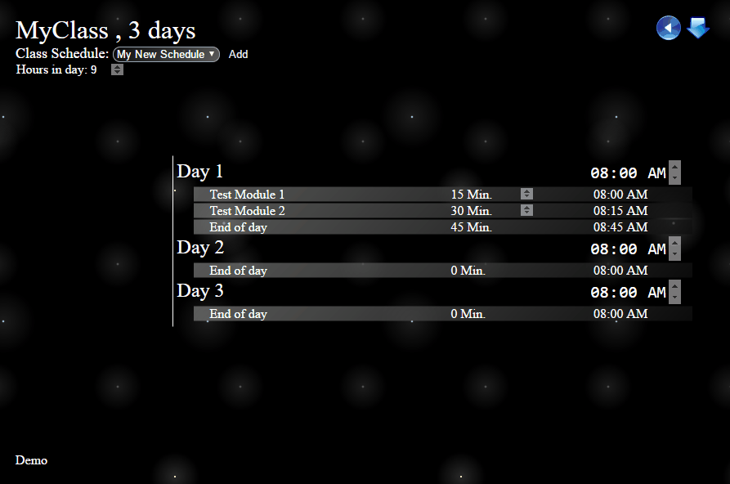
Change Module Color
Open Class
Right click module and press the drop down next to “Choose Color”
Use the color picker and alpha slider to choose desired color
Click away from color picker
* Enter presentation mode to view animations

Slide 11
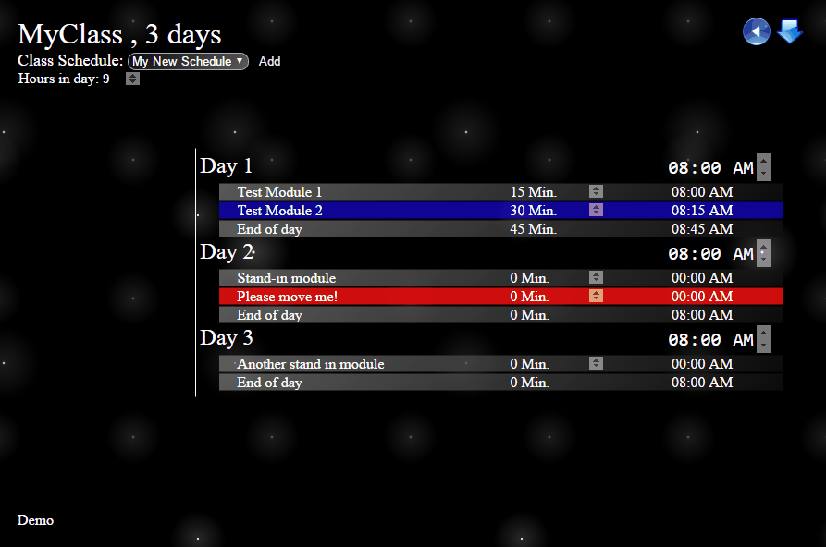
Move Module
Open Class
Click and hold module
Drag module to desired position
* Enter presentation mode to view animations

Slide 12
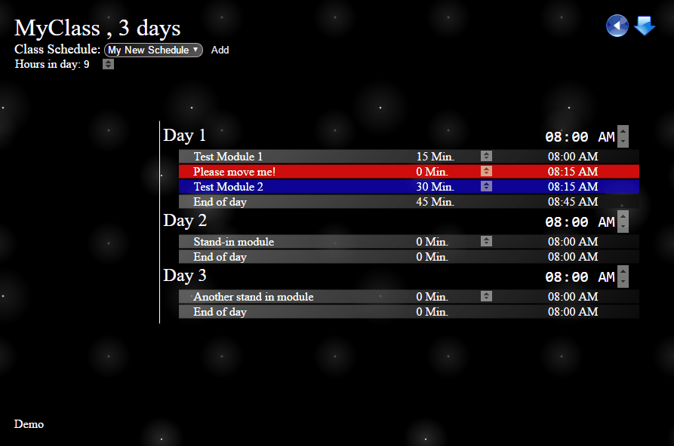
Delete Module
Open Class
Right click module
Choose “Delete”
* Enter presentation mode to view animations

Slide 13
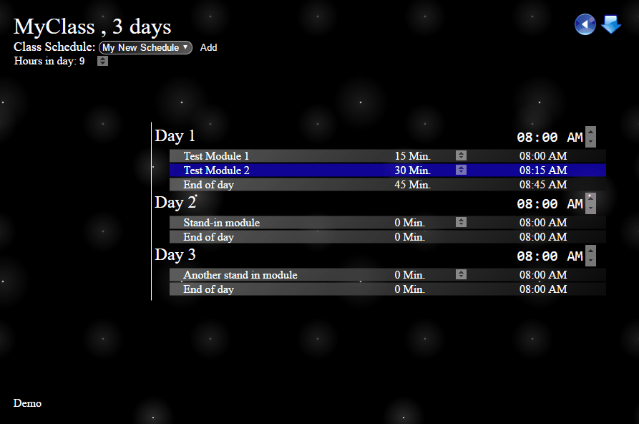
Create New Schedule
Open Class
Click the “Add” button at the top left near the schedule selector
Type in a new schedule name
Press enter
* Enter presentation mode to view animations

Slide 14
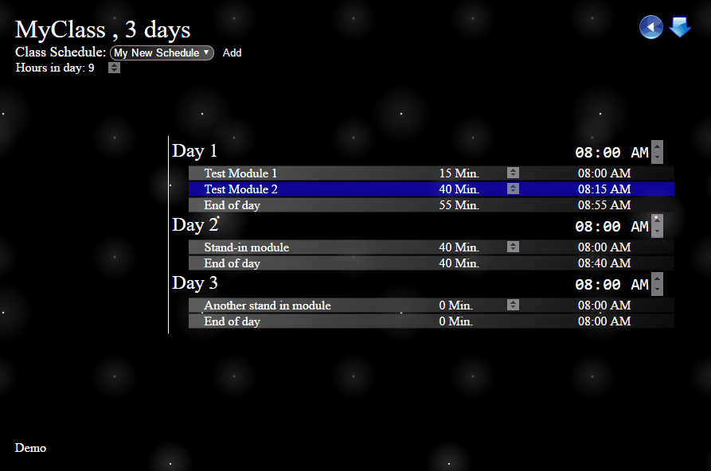
Add New Day
Open Class
Right click on day you want to enter a new day after
Choose “New Day”
Type name for new day
Press enter
* Enter presentation mode to view animations

Slide 15
Other

Slide 16



Additional Resources
Open source code hosted on github!
If you’d like to contribute see the git repository.
https://github.com/ScriptPup/ClassSchedule
Issue Tracking and Support
If you come across an issue, submit an issue.
https://github.com/ScriptPup/ClassSchedule/issues
Feature Requests
If you’d like a feature added, submit an issue with a title beginning with [FeatureRequest]
https://github.com/ScriptPup/ClassSchedule/issues

